Slide 1
Distributed Control and Automation Framework (DCAF)
Module Reuse
Benjamin Celis, Mathew Pollock, Simon Perez

Slide 2
Agenda
Class Project 1
Runtime Templates
Configuration Editor
Finding Modules
Configuration File

Slide 3
Agenda
Defining this chapter project.
Deciding on Runtime template
Exercise 1
Use runtime template
Explain parts of the template
Getting available modules,
Module Search path
Exercise 2
Getting new module
Adding it to search Path
Exercise 3
Create configuration
Script Includes
Deploy Tool
Notes:
On this lesson we will

Slide 4
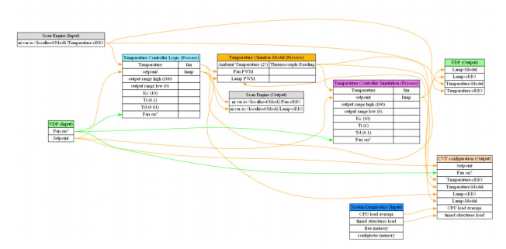
Exercise Project With Hardware
Temperature control Logic PID
Acquire Data Scan Engine
Log To Disk
UI
Notes:
Provide UI

Slide 5
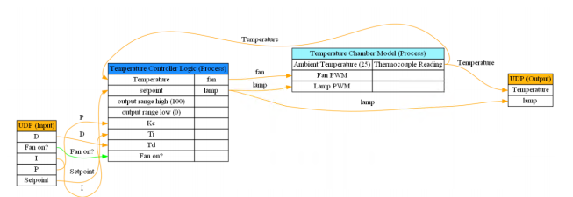
Exercise Project without Hardware
Temperature chamber simulation
PID Control
Log To Disk
UI

Slide 6
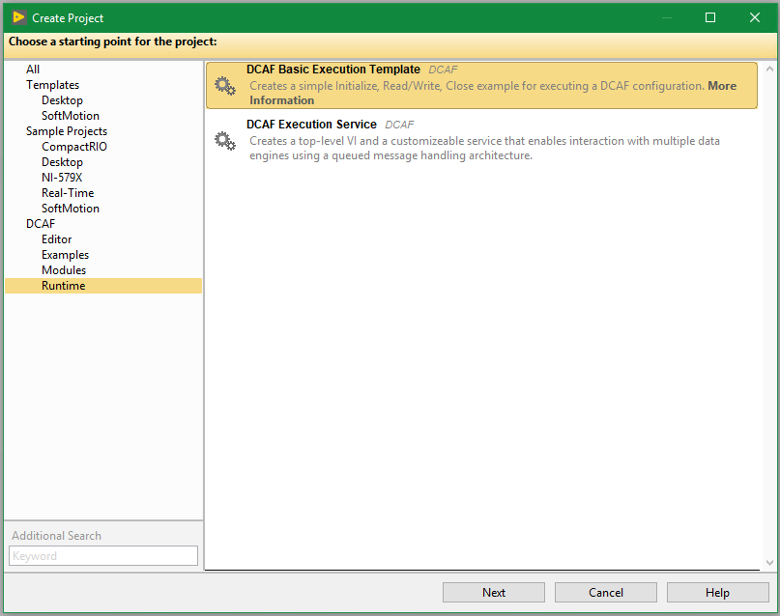
Runtime Templates

Slide 7
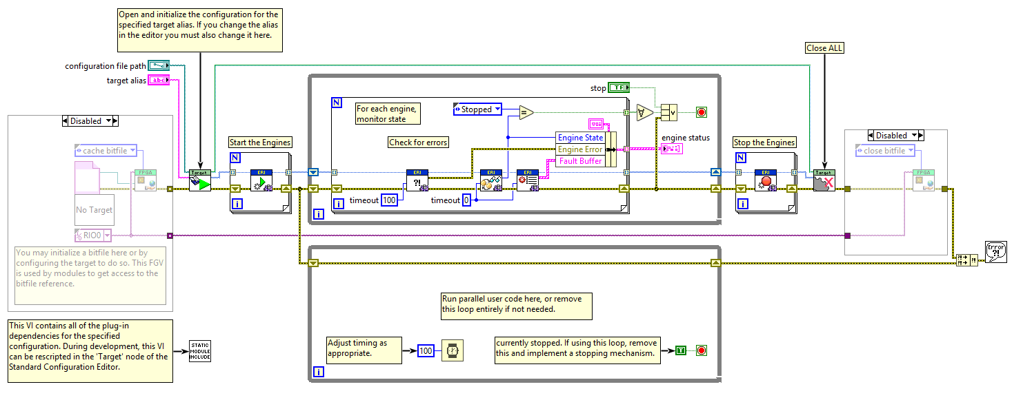
Basic Execution Template

Slide 8
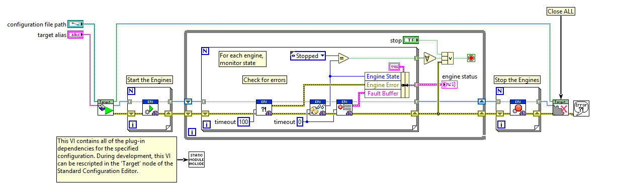
Most Common Case of the template

Slide 9
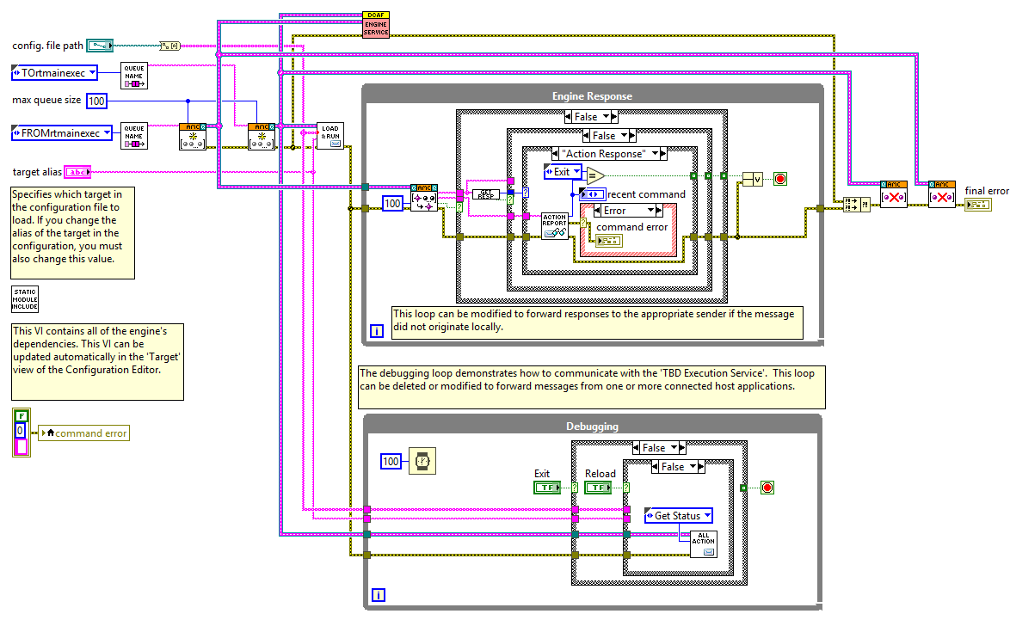
Services template

Slide 10
Exercise 1

Slide 11
Exercise 1
Create new folder
Create a execution Template
Optional Clean template

Slide 12
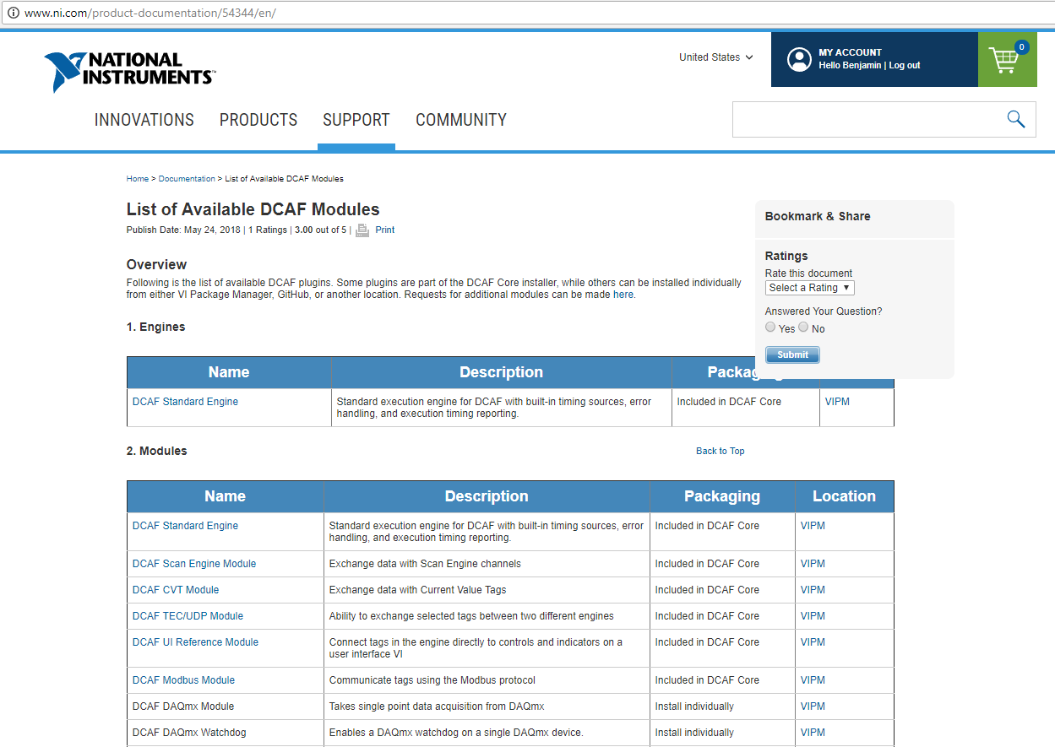
Available DCAF Modules
Notes:
http://www.ni.com/product-documentation/54344/en/

Slide 13
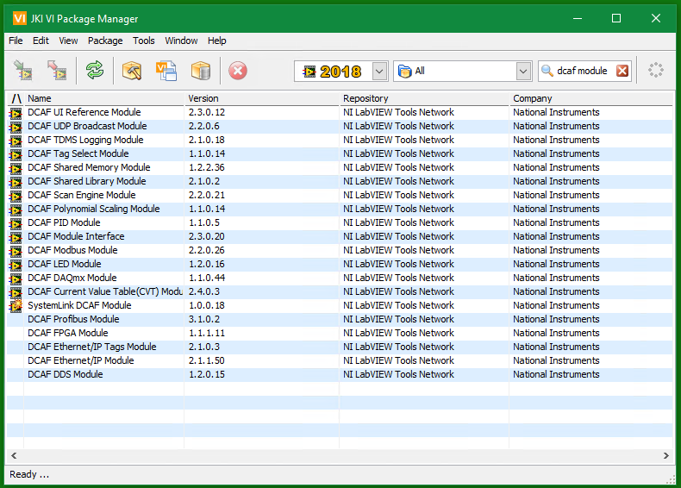
Available DCAF Modules

Slide 14
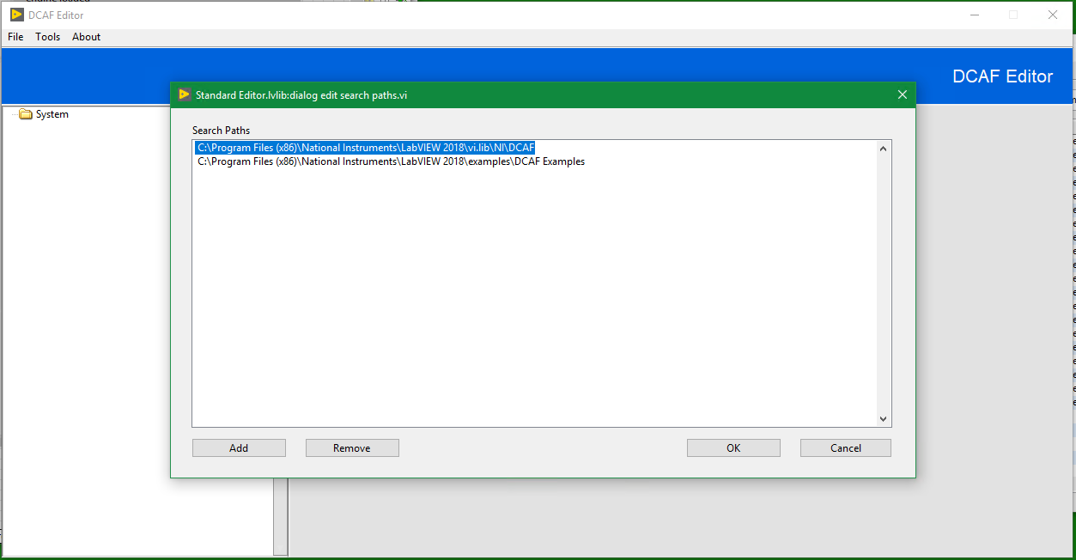
Search Paths

Slide 15
Exercise 2

Slide 16
Excerise 2
Add Examples Path
/LabVIEW / Examples/ Dcaf

Slide 17
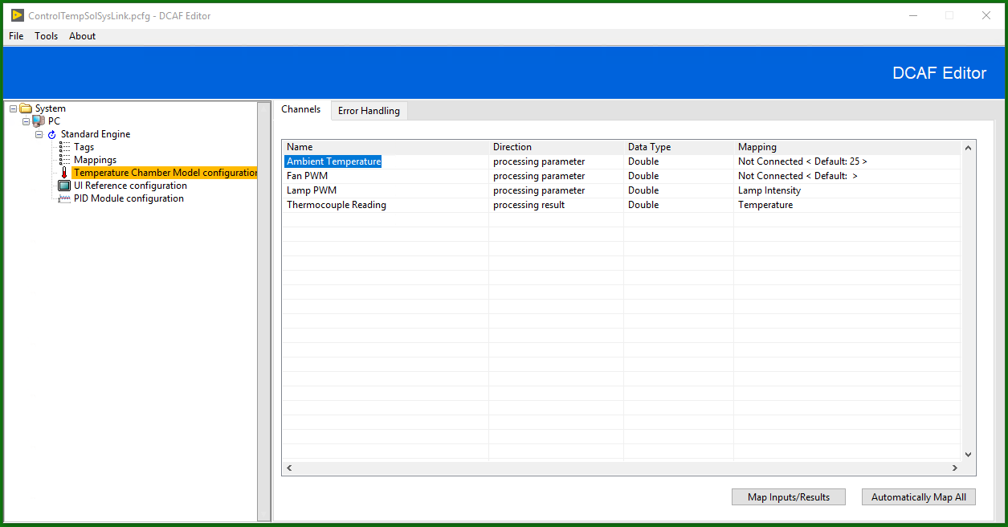
What type of module do I need

Slide 18
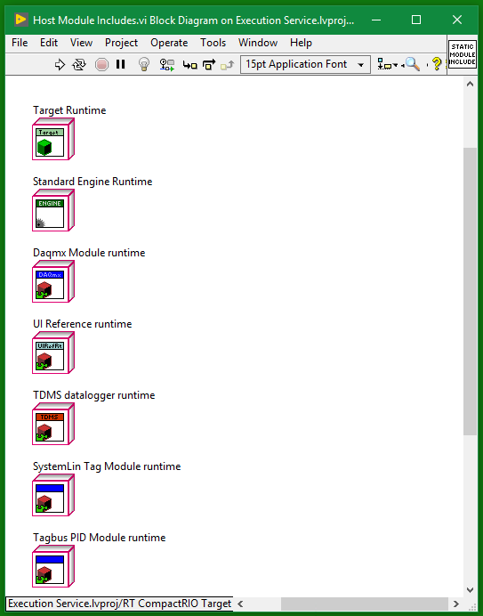
Script Includes
You should run this every time you add new modules to the configuration
It updates the includes VI

Slide 19
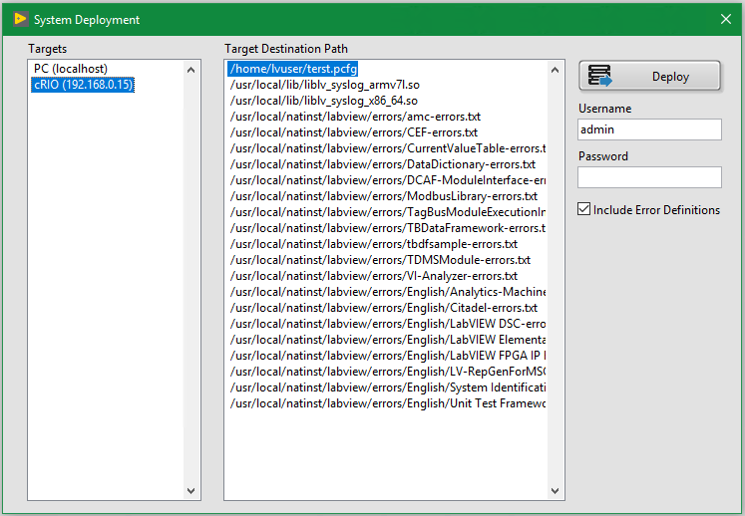
Deployment

Slide 20
Exercise 3

Slide 21
Exercise 3
Add Engine
Add Modules
Map Modules
Script Includes
Add UI to main
Run Code

Slide 22
Exercise 4
Optional

Slide 23
Exercise 4
Add second engine
Add UDP module
Configure UDP modules
Test

Slide 24
Conclusion
Before creating modules check available modules
Choose the right execution template
Create the configuration
Update include VIs
Deploy Configuration
Most likely you will need at least 1 custom module most likely a static module and that is cover on the next session

